Slide 1
Anovos Use Case Demo
Credit Risk Modeling

Slide 2
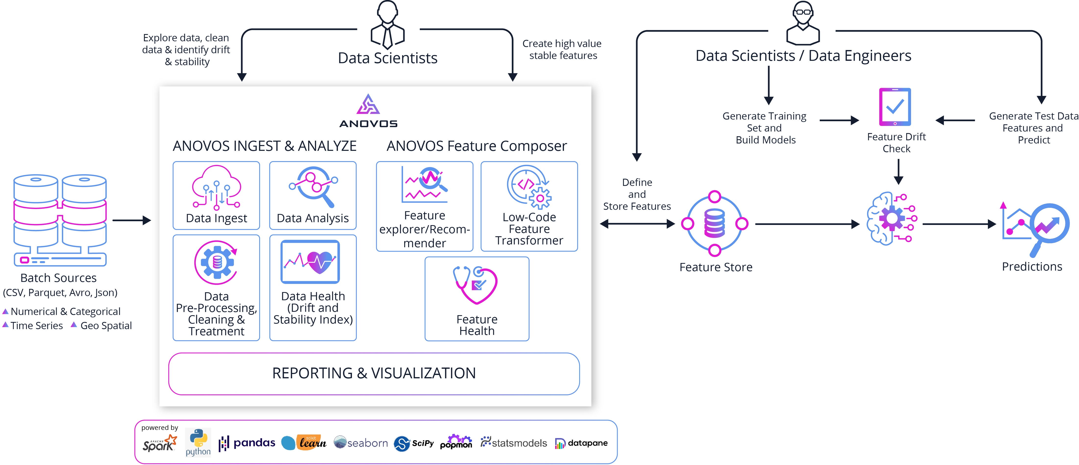
Anovos A Scalable Feature Engineering library using Apache Spark

Slide 3
Goal of Anovos
To implement a systematic feature engineering process
A majority of steps in feature engineering are ad hoc and trial-and-error based, making the output at each step vulnerable to error.
To add entirely new capabilities for data scientists
Data & Feature Stability: helps predict drift properties
Feature Recommender: addresses the cold start problem in feature composition
To enable scalable feature engineering
Anovos is built on top of the Spark distributed framework to support scale

Slide 4
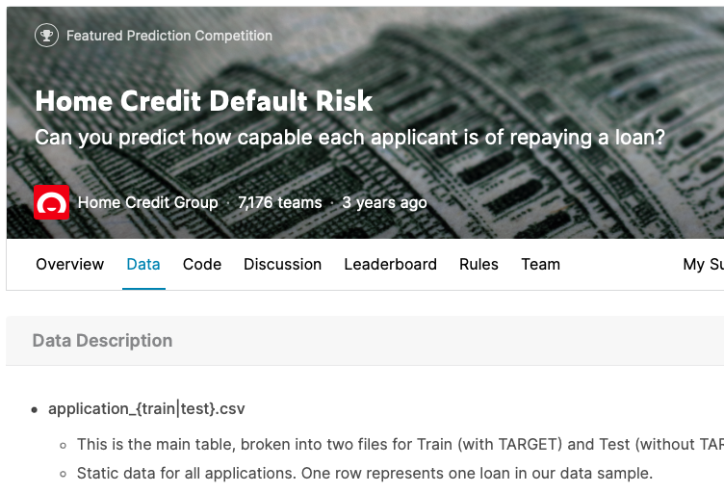
Demo Introduction
Use Case: credit risk modeling
Goal: to predict the capability of the applicants to repay their loan
Data Source: Kaggle Competition hosted by Home Credit Group (with slight modification)
https://www.kaggle.com/c/home-credit-default-risk

Slide 5
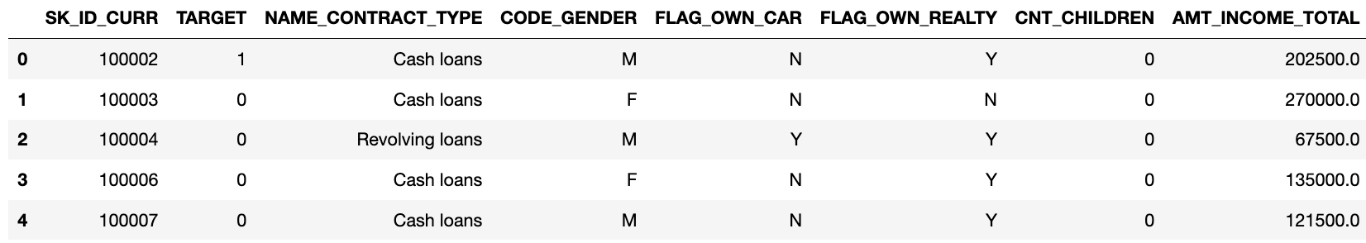
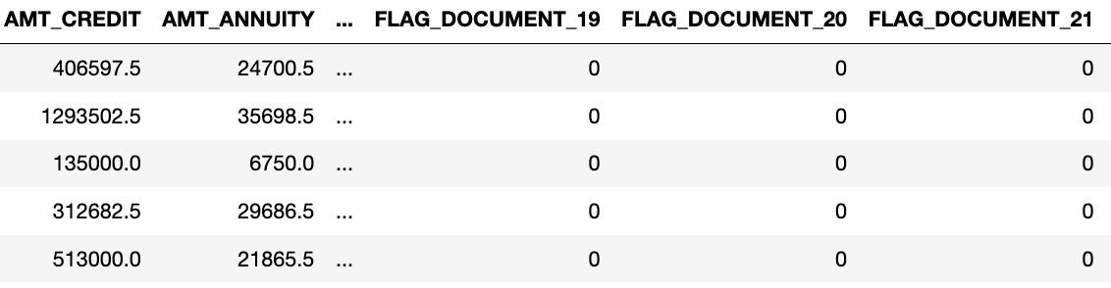
Dataset application_train.csv
Contains loan application data
Each row represents one loan
Data Schema
Identifier column: SK_ID_CURR (ID of the loan application)
Other application / applicant related attributes
Target variable: TARGET (1 - client with payment difficulties,
0 - all other cases)

Slide 6
Demo Workflow
Exploratory Data Analysis
Dimensionality Reduction
Using Anovos Report
Using Data Analyzer (including Data Cleaning)
Correlated Attributes Removal
Attributes with Low Importance Removal
Latent Features Generation
Feature Identification
Data Transformation
Feature Explorer & Recommender (FER)
Domain Knowledge
Stability Check (optional)
Cardinality Treatment
Data Rescaling
Missing Values Treatment
Categorical Attributes Encoding

Slide 7
Candidate Feature Set
The feature set suggested by the feature explorer/recommender
loan denied, years of credit history, previous loan grant, credit history
Custom features that may have been generated by the modeler
income per person, income credit percent, payment rate, etc
square of EXT_SOURCE_1, CNT_CHILDREN, etc
ln of AMT_GOODS_PRICE, AMT_INCOME_TOTAL, etc
All the base “characteristic” attributes in the original data set
DAYS_EMPLOYED, DAYS_BIRTH, AMT_INCOME_TOTAL, AMT_CREDIT, etc

Slide 8
Model Ready Features
Pruned Feature set from the existing features
CNT_CHILDREN, REGION_POPULATION_RELATIVE, FLAG_EMP_PHONE, FLAG_WORK_PHONE, FLAG_PHONE, FLAG_EMAIL, CNT_FAM_MEMBERS, REGION_RATING_CLIENT, REGION_RATING_CLIENT_W_CITY, HOUR_APPR_PROCESS_START, REG_REGION_NOT_LIVE_REGION, REG_REGION_NOT_WORK_REGION, LIVE_REGION_NOT_WORK_REGION, REG_CITY_NOT_LIVE_CITY, REG_CITY_NOT_WORK_CITY, LIVE_CITY_NOT_WORK_CITY, EXT_SOURCE_1, EXT_SOURCE_2, EXT_SOURCE_3, LANDAREA_AVG, BASEMENTAREA_MODE, YEARS_BEGINEXPLUATATION_MODE, ELEVATORS_MODE, ENTRANCES_MODE, FLOORSMAX_MODE, OBS_30_CNT_SOCIAL_CIRCLE, DEF_30_CNT_SOCIAL_CIRCLE, OBS_60_CNT_SOCIAL_CIRCLE, DEF_60_CNT_SOCIAL_CIRCLE, FLAG_DOCUMENT_3, FLAG_DOCUMENT_5, FLAG_DOCUMENT_6, FLAG_DOCUMENT_8, FLAG_DOCUMENT_11, AMT_REQ_CREDIT_BUREAU_HOUR, AMT_REQ_CREDIT_BUREAU_DAY, AMT_REQ_CREDIT_BUREAU_WEEK, AMT_REQ_CREDIT_BUREAU_MON, AMT_REQ_CREDIT_BUREAU_QRT, AMT_REQ_CREDIT_BUREAU_YEAR, DAYS_REGISTRATION, DAYS_BIRTH, DAYS_EMPLOYED, DAYS_ID_PUBLISH, DAYS_LAST_PHONE_CHANGE, NAME_HOUSING_TYPE, NAME_INCOME_TYPE, NAME_EDUCATION_TYPE, WEEKDAY_APPR_PROCESS_START, NAME_CONTRACT_TYPE, CNT_PREV_REFUSED_APP, DAYS_PREV_CREDIT_HISTORY,
Newly Composed Features
AMT_PREV_CREDIT_MIN, AMT_PREV_CREDIT_MAX, AMT_PREV_CREDIT_MEAN, CNT_PREV_APPROVED_APP, DAYS_EMPLOYED_PERC, INCOME_CREDIT_PERC, INCOME_PER_PERSON, ANNUITY_INCOME_PERC, PAYMENT_RATE, DAYS_START_EMPLOYED, EXT_SOURCE_1_sq, CNT_CHILDREN_sq, EXT_SOURCE_2_sq, EXT_SOURCE_3_sq, WALLSMATERIAL_MODE, OCCUPATION_TYPE, CODE_GENDER, NAME_TYPE_SUITE, NAME_FAMILY_STATUS, ORGANIZATION_TYPE, AMT_GOODS_PRICE_ln_scaled, AMT_INCOME_TOTAL_scaled, AMT_GOODS_PRICE_scaled, AMT_CREDIT_scaled, AMT_INCOME_TOTAL_ln_scaled, AMT_ANNUITY_ln_scaled, AMT_CREDIT_ln_scaled, AMT_ANNUITY_scaled, latent_0, latent_1, latent_2, latent_3

